Slide 1
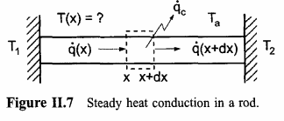
Heat Transfer in a Rod
Persamaan transfer panas satu dimensi
T = temperatur (K)
k = konduktivitas termal (W/mK)
P = perimeter tongkat (m)
h = rasio perpindahan energi

Slide 2
Heat Transfer in a Rod
Anggap k, A, dan P konstan:
T_{a} = 0 K
α = 1
Ti = 800 K
Tf = 400 K
L = 1 m

Slide 3
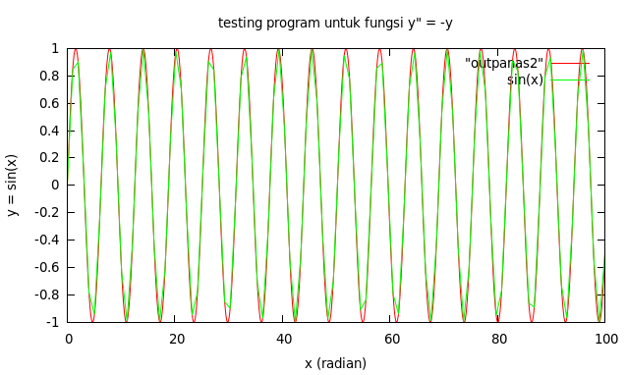
Heat Transfer in a Rod
Percobaan Runge-Kutta orde 4

Slide 4
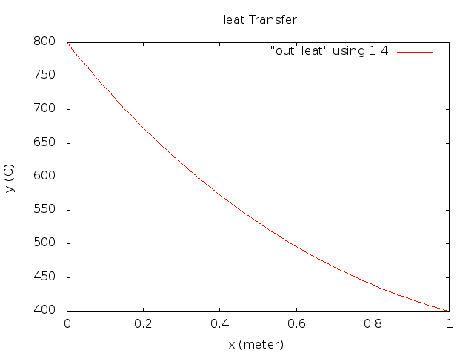
Heat Transfer in a Rod

